Slide 1
Selection Structure if…elif…else statement

Slide 2
Objectives
At the end of this lecture, you will understand
if..elif…else (Multiway Selection Statement)

Slide 3

Recall
You had learnt to calculate the BMI for a person.
What’s the purpose of this BMI?
How can you use it?
Notes:
We have been so familiar with BMI calculation. But Is BMI just to let us know, if one is obese or not?
This lecture, we will learn how to give more information to someone, based on their BMI.

Slide 4
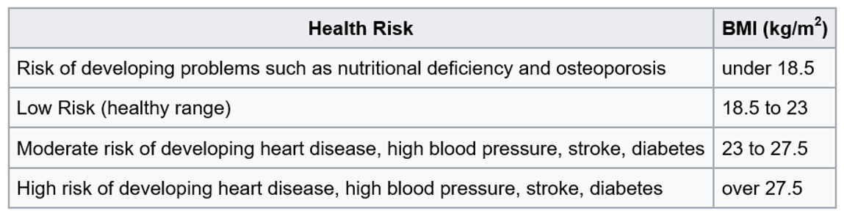
if…elif…else Multiway Selection
HR
HR1
HR2
HR3
HR4
Notes:
In Singapore, the BMI cut-off figures were revised in 2005. This was motivated by studies showing that many Asian populations, have higher proportion of body fat and increased risk for cardiovascular diseases and diabetes mellitus, compared with Caucasians, at the same BMI. The BMI cut-offs are presented, with an emphasis on health risk, rather than weight.

Slide 5
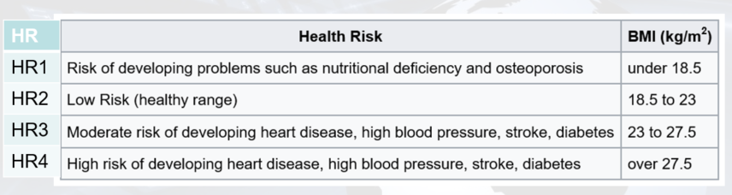
if…elif…else Multiway Selection
Flowchart:
true
BMI < 18.5
display HR1
false
true
BMI < 23
display HR2
false
true
BMI < 27.5
display HR3
false
display HR4
Notes:
So now we are going to advise Tom on the potential health risks based on the BMI values. We could display different health risk messages depending on the range that the given bmi falls within.
If BMI is less than 18.5, then the first health risk message about nutritional deficiency, will be displayed. Otherwise. if BMI is less than 23, the second health risk message, that there is low risk, will be displayed. Else if, BMI is less than 27.5, display moderate risk. And lastly, if the BMI does not fall within any of the range mentioned earlier, display that there is high risk.

Slide 6
if… elif…else Multiway Selection
Selects from various course of actions depending on the decision made
General format:
default (catch-all) condition is
the else statement (optional)
true
Condition_1
Do Action_1
if condition_1:
true_statement_1
elif condition_2:
true_statement_2
elif…
…
else:
false_statement
false
true
Condition_2
Do Action_2
false
.
.
.
Do Action_N+1
.
.
.
Notes:
Displaying different health risk messages, based on bmi values, is an example of multiway selection, in which we select from multiple courses of action. We have also seen how a flowchart for multiway selection looks like, in the earlier slide.
The white box shows the format, of how a multiway selection is typically written in python code, with the use of if, else-if and else keywords. The else block, is the default condition, which will be executed, when all earlier condition checks give Boolean false.
Sometimes, in a multiway selection, there may be no default condition, in which case, there will only be if and else-if, but no else block.

Slide 7
if…elif…else Multiway Selection
Pseudocode:
IF BMI < 18.5 THEN
display "Risk of developing osteoporosis"
ELSE IF BMI < 23 THEN
display "Healthy"
ELSE IF BMI < 27.5 THEN
display "Low risk of developing heart disease, stroke, etc."
ELSE
display "High risk of developing heart disease, stroke, etc."
ENDIF
Notes:
The algorithm can be expressed in the form of pseudocode as shown, with the use of if, else-if and else again.

Slide 8
if…elif…else Multiway Selection
The algorithm can be translated into Python code as follows:
if bmi < 18.5:
print ("Risk of developing osteoporosis")
elif bmi < 23:
print ("Healthy")
elif bmi < 27.5:
print ("Low risk of developing heart disease, stroke, etc.")
else:
print("High risk of developing heart disease, stroke, etc.")
Notes:
When the algorithm is translated to python code, it will look like this. Notice that the statements in the if, else-if or else block are indented, so that they are clearly in the respective blocks.
Incorrect indentation, or failure to indent at all, will result in errors in your python program.

Slide 9
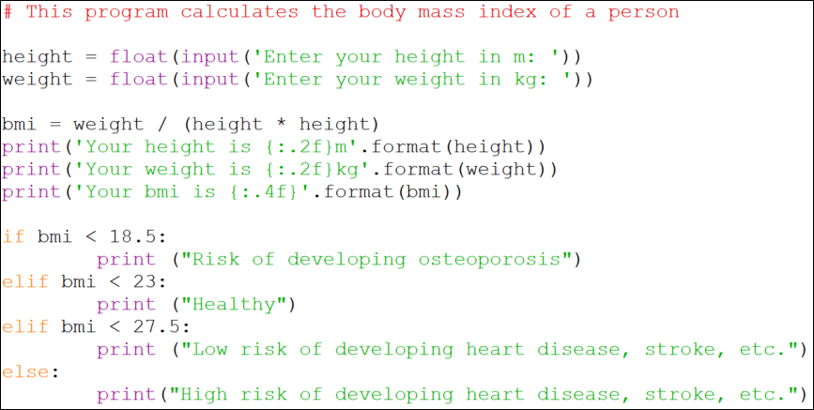
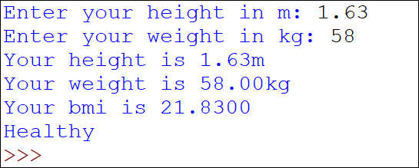
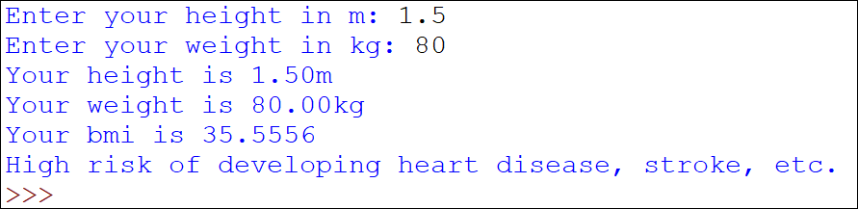
CalculateBMI.py - Program
Output
Notes:
Now, we can incorporate the code for the multiway-selection, in our calculate bmi program. Try typing it out, and observe the output, when you provide various weights and heights that generate bmi values, fulfilling different condition checks.

Slide 10
Multiway Selection
Is it necessary to specify both the upper and lower limit of the range of values?
if bmi < 18.5:
print("Risk of developing osteoporosis")
elif 18.5 <= bmi < 23:
print("Healthy")
elif 23 <= bmi < 27.5:
print ("Low risk of developing heart disease, stroke, etc.")
elif bmi >= 27.5:
print("High risk of developing heart disease, stroke, etc.")
Checking of unnecessary conditions
➔ waste of resources
➔ inefficient!
Notes:
Very often, programmers make the mistake, of specifying both the upper and lower limits, as shown. If you look carefully, the limits in red, are redundant.
For example, if the execution of the program managed to reach the third line, of checking if bmi is less than 23, then the previous condition, that checks that bmi is less than 18.5, was definitely false. This means that the bmi, must be more than or equals to 18.5.
Thus, specifying the lower limit of checking if bmi is more than or equals to 18.5, in the first else-if statement, is redundant. This results in extra CPU time being utilized to execute that additional condition check! The code will also be less efficient.

Slide 11
Multiway Selection
How about using multiple if statements?
if bmi < 18.5:
print("Risk of developing osteoporosis")
if 18.5 <= bmi < 23:
print("Healthy")
if 23 <= bmi < 27.5:
print ("Low risk of developing heart disease, stroke, etc.")
if bmi >= 27.5:
print("High risk of developing heart disease, stroke, etc.")
bmi < 18.5
true
print HR1
false
18.5≤bmi<23
true
print HR2
false
23≤bmi<27.5
true
print HR3
false
Checking of more conditions again
➔ waste of resources
➔ inefficient!
bmi >=27.5
true
print HR4
false
Notes:
Look at this code. What’s wrong? In this code segment, consecutive if statements are used, instead of using if, else-if and else. If multiple ifs are used, that means all the specified if conditions, will be evaluated, and it is unnecessary for this scenario.
For bmi values that are less than 18.5 and thus already fulfill the first condition, we wouldn’t want to do the check if bmi is more than or equals to 18.5, and less than 23, as well as other condition checks further down. Again, additional CPU time is used to execute the redundant condition checks, and the code will be less efficient, since it will take up more time to run!

Slide 12
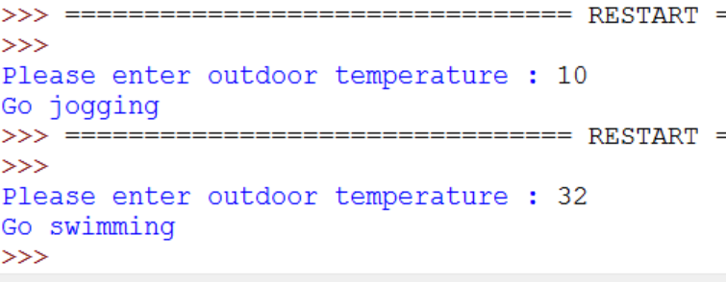
Activity 1 – DetTempActivity.py
If you are living in UK or Canada, you made plans to do various activities based on the outdoor temperature as follows:
Draw a flowchart and translate the algorithm to a program recommends the activity given the temperature.
Temperature | Activity
-5 and below | Go Bowling
between -5 and 0 (inclusive) | Go Skiing
between 0 and 20 (inclusive) | Go Jogging
between 20 and 25 (inclusive) | Play Tennis; wear white clothes
between 25 and 30 (inclusive) | Go Sun-tanning in the park
above 30 | Go Swimming
Notes:
Now, let us apply the use of multiway selection, in another scenario. Let’s assume you are living in a temperate country with 4 seasons. You are making plans to do different activities, based on the varying outdoor temperature. Figure out the flowchart, and translate the algorithm to a python program, that will give appropriate activity recommendation, based on the temperature given by the user.

Slide 13
true
Temp<=-5
Display Go Bowling
false
true
Temp<=0
Display Go Skiing
false
Temp<=20
true
Display Go Jogging
false
true
Display Go Play Tennis, wear white clothes
Temp<=25
false
true
Display Go Sun-tanning in the park
Temp<=30
false
Display Go Swimming

Slide 14
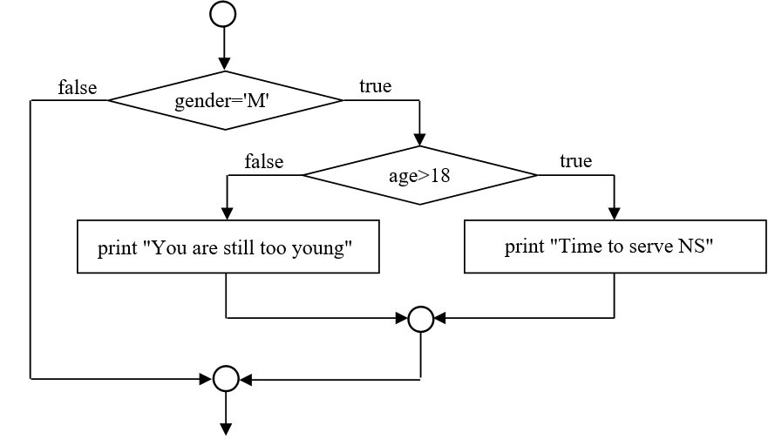
Nested Selection Statements
In some cases you may want one decision to depend on the result of an earlier decision.
E.g. To display that a male citizen has to serve National Service (NS) if he is above 18 years old and to display that he is too young otherwise.
A nested if example
.
.
.
Notes:
Sometimes in more complex scenarios, you may find yourself making a decision, only if an earlier decision is made.
Then, we have the case of nested selection structures, in which you first make a conditional check, and depending on whether it is true or false, you will do subsequent conditional checks accordingly, in order to execute the appropriate course of action.
Here is an example of a nested if structure.

Slide 15
Nested if Statements
if gender == 'M':
if age > 18:
print('Time to serve NS')
else:
print('You are still too young')
inner if statement, statements in the inner if block are further indented.
This is equivalent to putting an inner if statement within the body of another if statement
The body of the outer if statement is indented, and the body of the inner if..else statement is indented one more time
Notes:
It is important to note that, the code in the inner selection structure, needs to be further indented, in order to be part of the inner if or else block.

Slide 16
Activity 2
What is the expected output if the mark input is:
25, -10, 70, 101
‘You have failed’ , ‘Invalid mark’ , ‘You have passed’/n‘Good job done’ , ‘You have passed;Good job done’
if mark > 0 :
if mark >= 50:
print('You have passed')
print('Good job done')
else:
print('You have failed')
else:
print ('Invalid mark')
Notes:
What do you think, are the expected output of this code segment, given the following mark inputs?

Slide 17
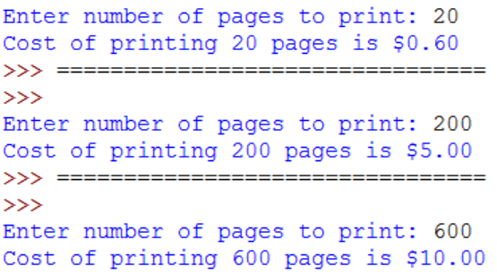
Activity 3 –CalCost.py
The rate for photocopy in a printing shop is as follows:
First 100 pages: 3 cents per page
Next 200 pages: 2 cents per page
Over 300 pages: 1 cent per page
Calculate the cost for printing based on the number of pages input.
Notes:
What if now, you need to write a program, that performs different calculations to obtain cost of printing, depending on the number of pages to be printed?

Slide 18
Reading Reference
How to Think Like a Computer Scientist: Learning with Python 3
Chapter 5
http://www.openbookproject.net/thinkcs/python/english3e/conditionals.html

Slide 19
Summary
The if…elif…else (Multiway-Selection Statement) chooses from various course of actions depending on which of the conditions evaluates to true.

